Slide 1


Cornell MEng Data Forecasting Project Week 5
Team: Abhishek Dixit, Benjamin Elbaz,
Anqi Huang, Shuang Wei
Advisor: Kris Iyer
Date: Feb 8th, 2016

Slide 2
Objective: Explore the Activyl Sales Data from Merck to Distributors
Methodology:
Aggregate the quantity for each SKU on the monthly level
Plot the distribution

Slide 3
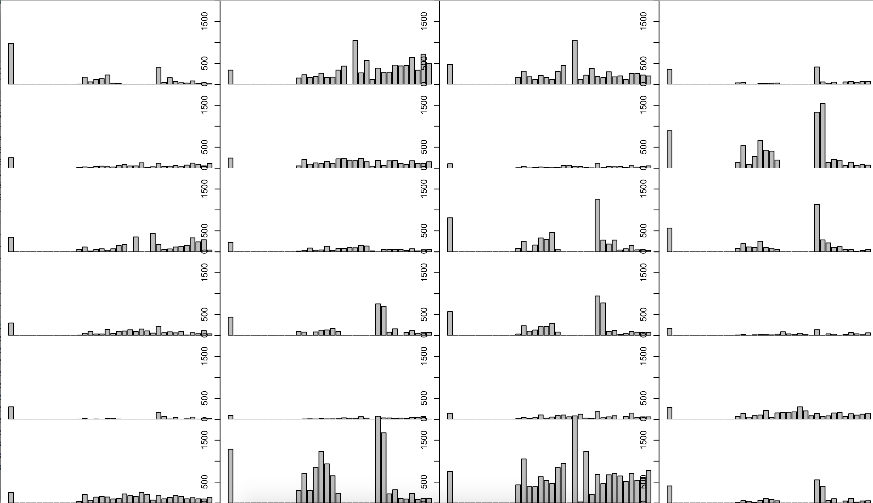
Distribution Plots of Activyl

Slide 4
Correspondence between sales in, sales out and inventory
Methodology:
Select one SKU
Sales In = Sales from Merck to Distributors
Sales Out = Sales from Distributors to Vets
Sales In(month) = Inventory(end month)- Inventory(start month) + Sales Out(month)

Slide 5
Next Steps: - Build a tableau with three sets of data
- Start forecasting data

